Slide 1

🔷 Object-Oriented Design (OOD)
An Introduction to Principles, Concepts & Practices
Presented by: Raghav Panthi

Slide 2

What is Object-Oriented Design?
Definition:
Object-Oriented Design is a method of designing a system by modeling it using classes and objects.
Focus Areas:
Real-world entities
Modular, reusable components
Encapsulation of data and behavior
Goal:
To build software that is maintainable, scalable, and understandable.

Slide 3
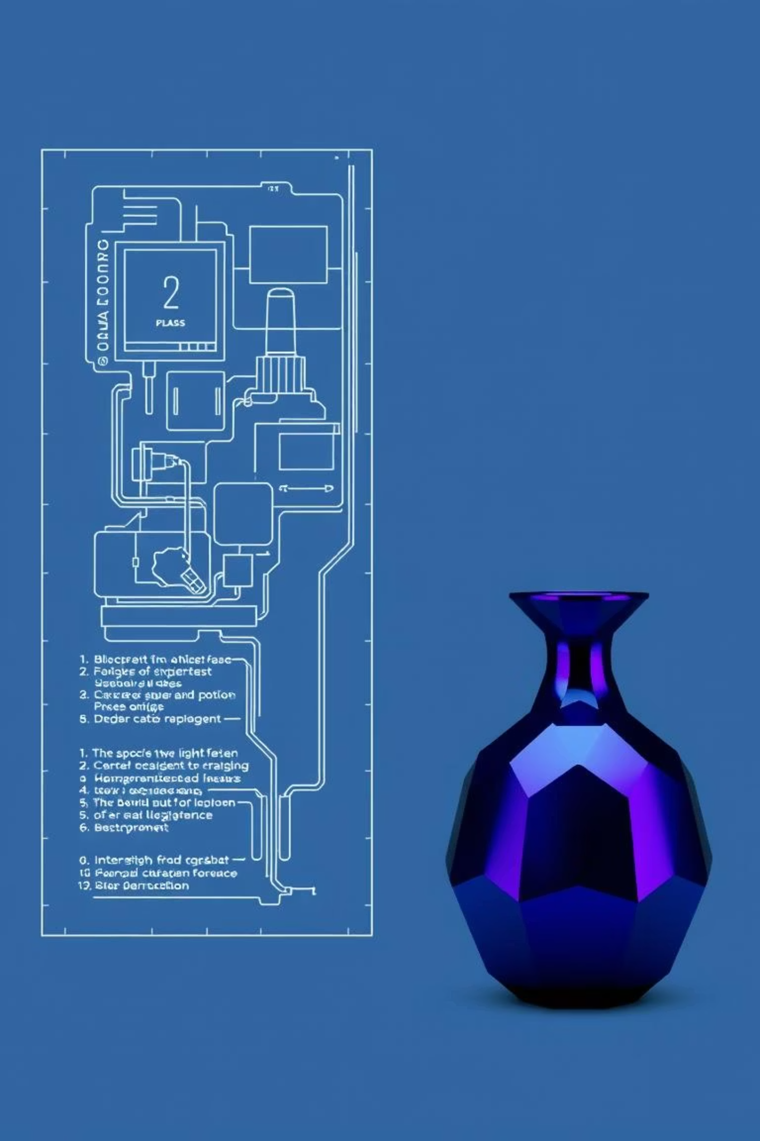
Core Concepts of OOD
Class:
Blueprint for creating objects.
Object:
Instance of a class.
Attributes:
Data members of a class.
Methods:
Functions that define behaviors.
Example: A Car class may have color (attribute) and drive() (method).

Slide 4
Four Pillars of Object-Oriented Design
1. Encapsulation
2. Abstraction
Definition: Hiding internal data and providing access through public methods.
Definition: Showing only essential features.
class BankAccount {
private double balance;
public void deposit(double amount) {
balance += amount; }
public double getBalance() {
return balance; } }
abstract class Animal { abstract void makeSound(); }
class Dog extends Animal { void makeSound() { System.out.println("Bark"); } }
3. Inheritance
4. Polymorphism
Definition: Acquiring features from another class.
Definition: Same method behaving differently in different classes.
class Vehicle {
void start() { System.out.println("Vehicle started"); } } class Car extends Vehicle {
void honk() {
System.out.println("Car honking"); } }
class Shape {
void draw() { System.out.println("Drawing Shape"); } }
class Circle extends Shape {
void draw() {
System.out.println("Drawing Circle"); } }

Slide 5
OOD vs. Procedural Design
Feature
Procedural Programming
Object-Oriented Design
Structure
Sequence of functions
Objects and Classes
Data Handling
Shared
Encapsulated
Reusability
Low
High
Scalability
Moderate
High

Slide 6
Benefits of Object-Oriented Design
Modularity
Code Reusability
Easier Maintenance
Improved Collaboration
Real-World Mapping
Enhanced Flexibility and Scalability

Slide 7
OOD Process Steps
Requirements Gathering
Identify Classes and Objects
Define Relationships (Aggregation, Inheritance, etc.)
Create UML Diagrams
Design Interfaces and Interactions
Refine and Review

Slide 8
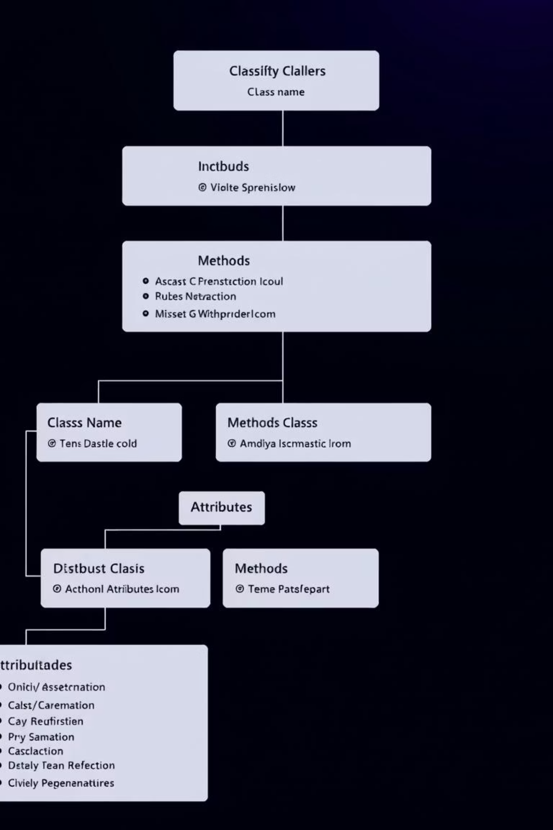




UML in OOD
UML (Unified Modeling Language): Standard way to visualize OOD.
Class Diagram
Sequence Diagram
Use Case Diagram
Activity Diagram
Helps in communication and documentation.

Slide 9

Real-World Example
Banking System Example:
Classes:
Account, Customer, Transaction
Relationships:
A Customer has multiple Accounts
Inheritance:
SavingAccount and CheckingAccount inherit from Account
Polymorphism:
Different versions of calculateInterest()

Slide 10

Conclusion & Summary
Object-Oriented Design helps build maintainable and robust software.
Focuses on modeling real-world scenarios.
Based on encapsulation, abstraction, inheritance, and polymorphism.
Widely used in modern software development.
Thank You! Questions?

